Slide 1


Notes:
Realization of a dream started in 1996
Got a group of a half-dozen technology experts in Roxbury and JP
Set up Roxbury, Dorchester and Mattapan.com as community information web sites
Wanted to accept information from CBOs
Did free trainings on using the web and e-mail
Fizzled out later that year due to lack of resources
In 2000, found out that Fleet was going to do a technology project in several low-income communities including Roxbury
Project is called CommunityLink
Our purposes met, and Roxbury.com got the sponsorship boost it needed before to bring it to fruition

Slide 2
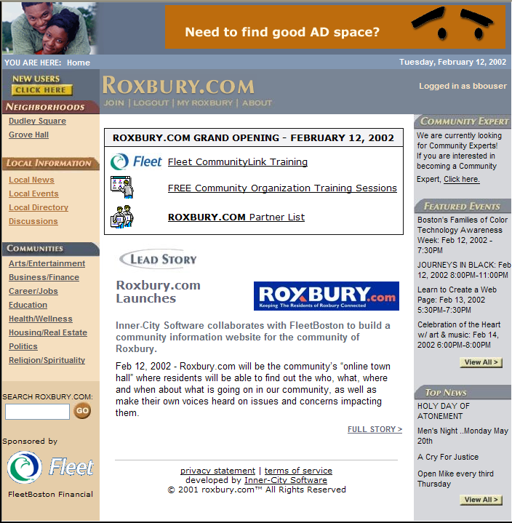
Home Page
Notes:
What is Roxbury.com?
News, Events, local directories, discussions and other information of interest to the community of Roxbury
What’s different about Roxbury.com?
It is built, managed and maintained by local residents and other stakeholders in the success of Roxbury and its neighboring communtiies
Much of the News comes from Bay State Banner
The events listings come from local CBOs
CBOs and local businesses can list themselves in the directory and promote their events for FREE
Local residents can keep up with what is going on in their neighborhood for FREE
Let’s go on a quick tour of Roxbury.com:

Slide 3
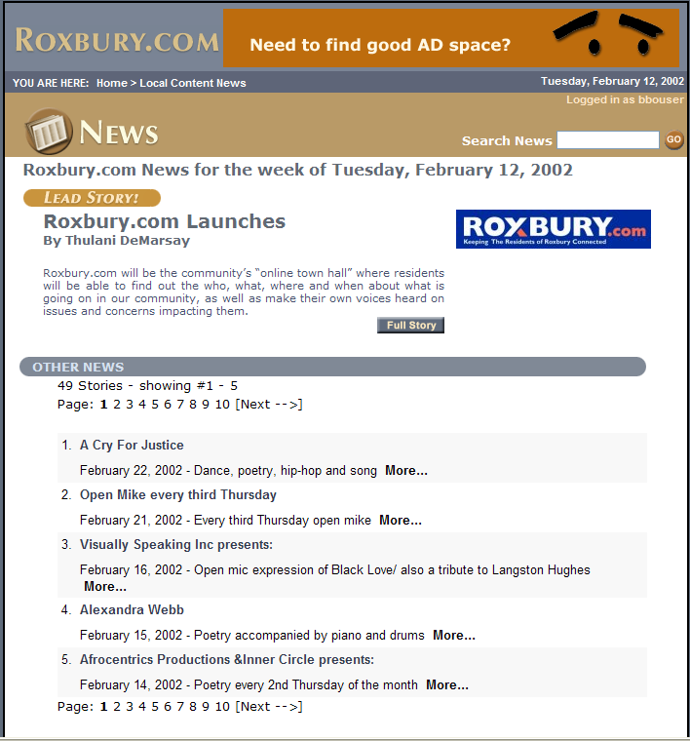
Local News
Notes:
This is the main News Page of Roxbury.com. Our current story is, naturally, the launch of the web site, but you can click on other news stories below or use the Search feature to find any News in the system.
Let’s click on the Full Story button to see “the rest of the story.”

Slide 4
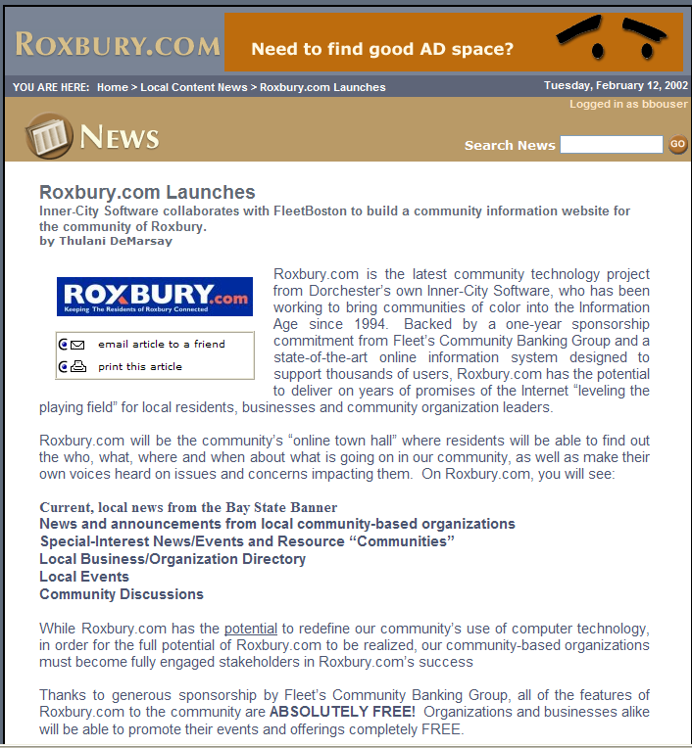
Local News
Notes:
This is the full story of the Roxbury.com launch.
While we at ICS entered this story, local CBOs have the same ability to post stories of their activities and other announcements.
We also have a partnership with the Bay State Banner where we automatically get their news each week. We are looking to create similar partnerships with other local news agencies.

Slide 5
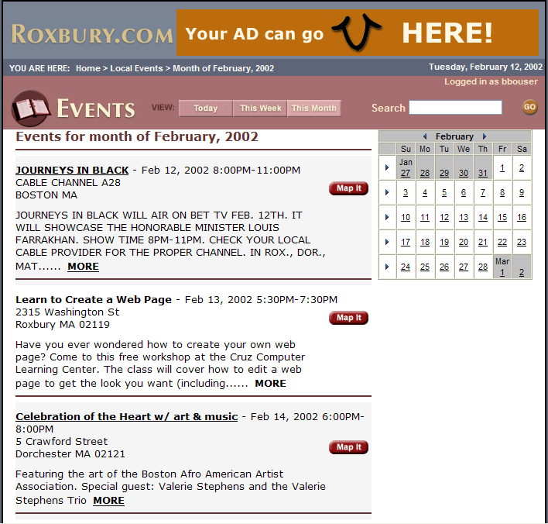
Local Events
Notes:
This is the Roxbury.com Calendar of Events.
You can browse Events by the current month, week or day, and use the handy calendar on the right to look at other months.
You can also use the Search feature to search for Roxbury events.
Let’s take a look at the ‘Create a Web Page’ event.

Slide 6
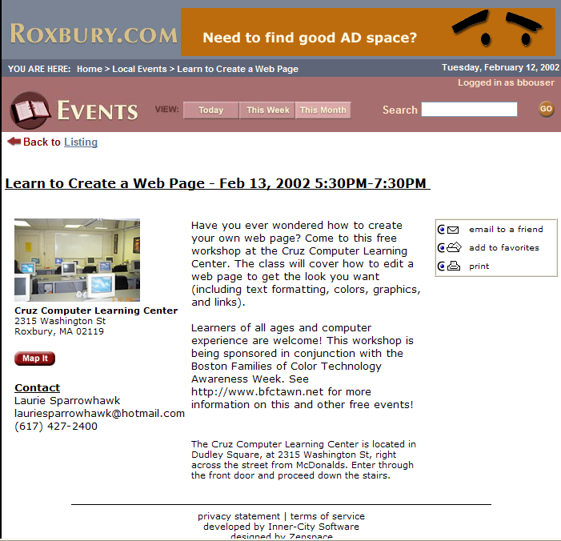
Event Details
Notes:
This event was submitted by the Cruz Computer Learning Center in Dudley.
You can see a picture of the center as well as read about their classes.
You can also e-mail any Roxbury.com events to friends and family, as well as add events to your own Roxbury.com personal calendar.
Let’s move on to the Directory.

Slide 7
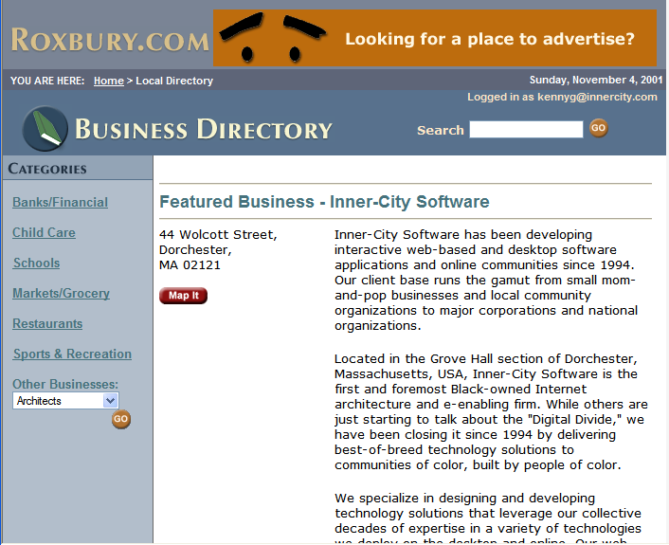
Local Directory
Notes:
The Roxbury.com Directory is similar to a Yellow Pages for Roxbury, except that it is online, and it is FREE to list your business or organization.
You can look up businesses and organizations by browsing categories or using the Search feature.
Let’s go looking for something to eat. We’ll start by clicking on Restaurants on the left side of the screen.

Slide 8
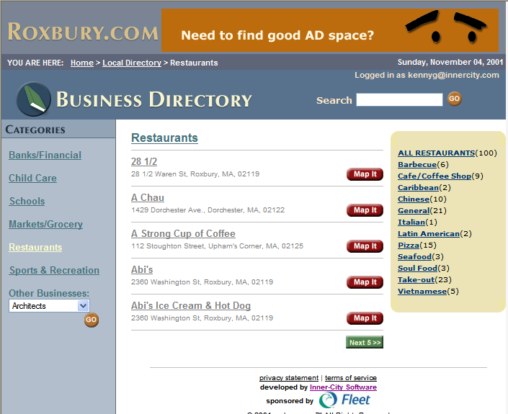
Restaurant List
Notes:
Now we are in the Restaurants section of the Directory.
On the right, we see a listing of different cuisines.
Let’s say you have a taste for Soul Food. Looks like there are 3 Soul Food restaurants listed.
Let’s click on Soul Food.

Slide 9
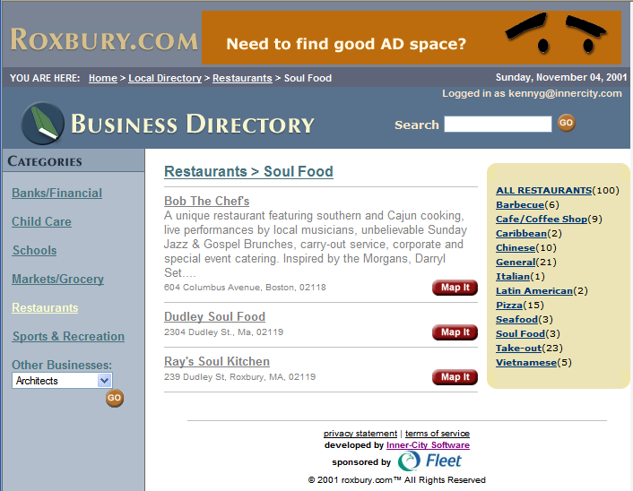
Soul Food Restaurants
Notes:
Now, here are the Soul Food restaurants in the directory. Let’s take a look at Bob the Chef’s.

Slide 10
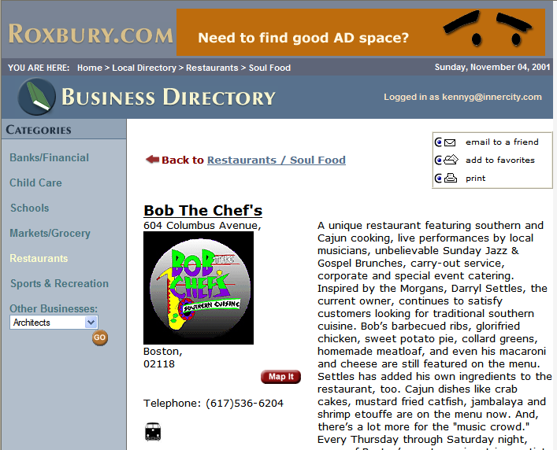
Business Details
Notes:
As you can see in the listing for Bob the Chef’s, a business can post their logo or other picture as well as enter a description of their products or services.
This is a good time to mention that we will be enhancing Roxbury.com over time, and one of the first major enhancements will be the ability for CBOs and businesses to use Roxbury.com to create their own FREE mini-web site in the Directory.

Slide 11
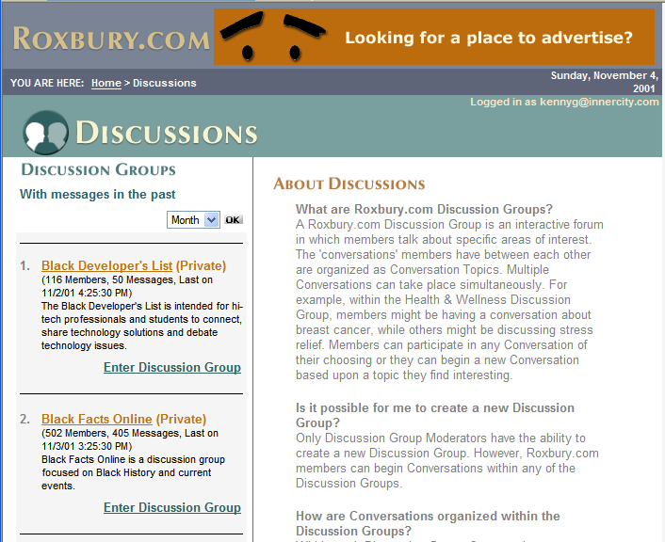
Discussions
Notes:
Discussions main page.
Let’s take a look at Boston Blacks Online.

Slide 12
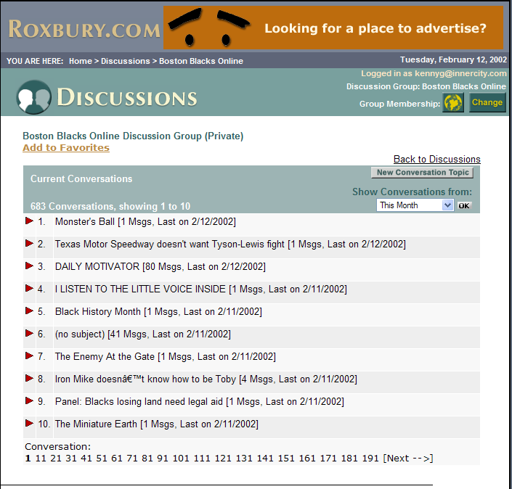
Conversation List
Notes:
This is the Boston Blacks Online discussion group, which currently has 600 members. People discuss every topic under the sun here, from politics to pop culture.
I noticed a discussion about finding transitional housing. Let’s take a look.

Slide 13
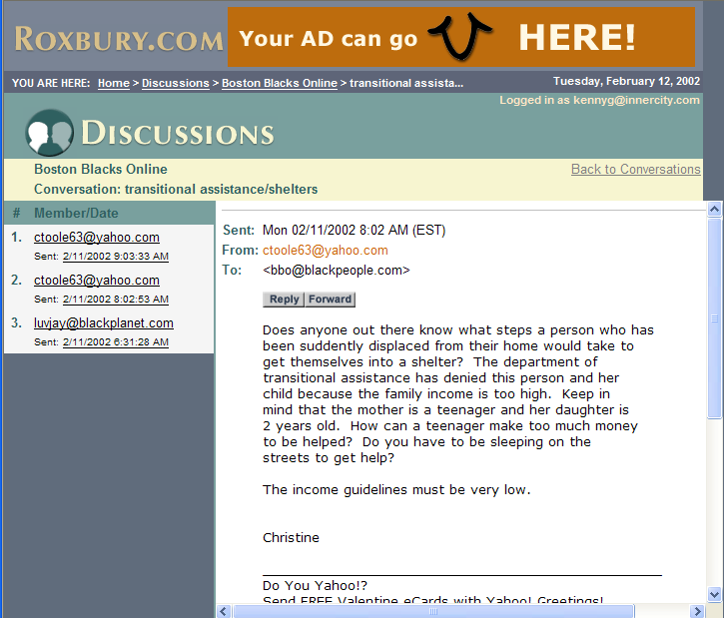
A Conversation
Notes:
Each conversation shows the different people and messages they have posted.
The discussions module is where residents will really be able to assist each other out, whether it is in finding work, a place to eat, or housing as in this message.

Slide 14
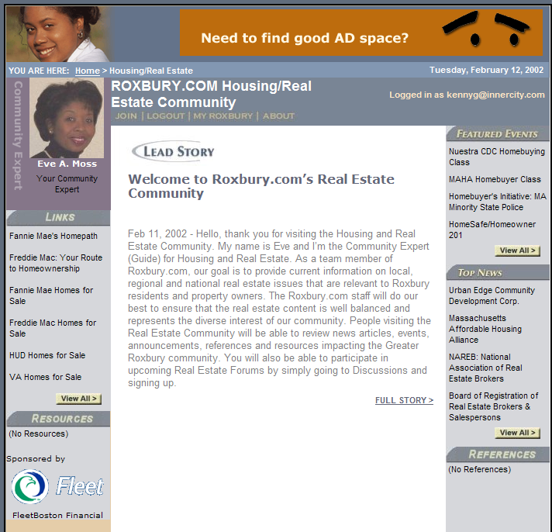
Politics Community
Notes:
Roxbury.com also has special interest areas on the arts, housing, business and finance, politics, and several other topics. Each area will be moderated by a local expert in the field who we call a Community Expert.
For instance, our Housing/Real Estate CE is Eve Moss of Clarendon Real Estate Advisors, and she is sharing a variety of important information concerning housing and real estate with the community via the links, events and announcements she has posted here.

Slide 15
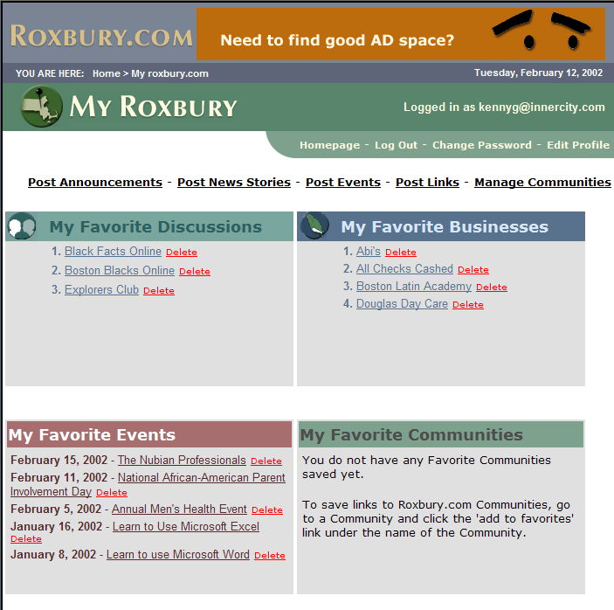
Politics Community

Slide 16
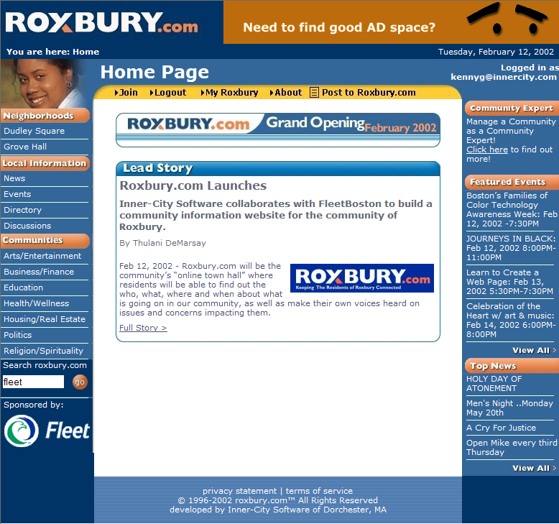
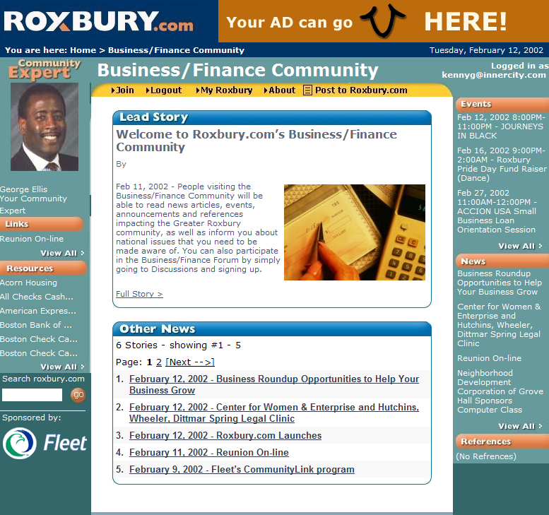
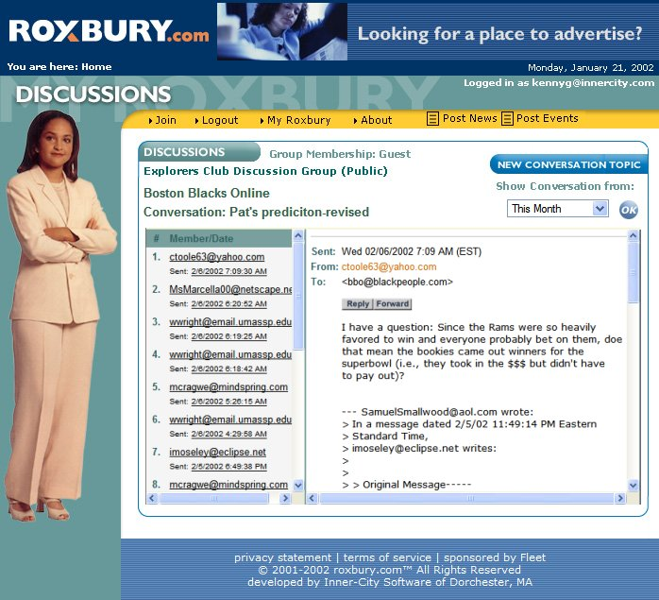
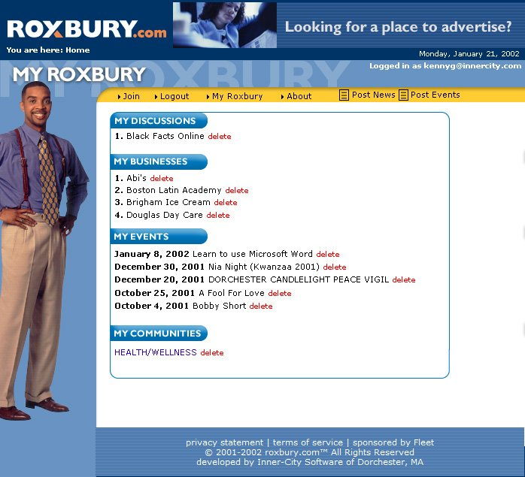
Home Page
Notes:
As Roxbury.com has been on our minds at ICS for years, we have lots of innovative and exciting ideas for it and we will be continually enhance it as time moves on.
For instance, although we are just opening, we are already about to give the site a major face lift with some of the most appealing and easy-to-use visuals and navigation you have seen in a community web site.
We also have several innovative technical enhancements in the works that will make it easier and easier for CBOs to post their announcements and events to Roxbury.com

Slide 17
Home Page
Notes:
Thank you for coming out today to support Roxbury.com! Please note that in order to keep Roxbury.com free for the community, we will be accepting advertising soon, so when you get a letter or e-mail from Roxbury.com concerning advertising or sponsorship, you will know that your dollars will help keep Roxbury.com free for the community.
Thank you again, and see you online!

